Slide 1
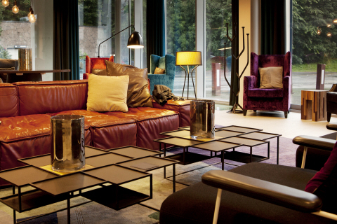
SCANDIC ACQUIRES RICA faCt SHEET 11 februarY 2014

Slide 2
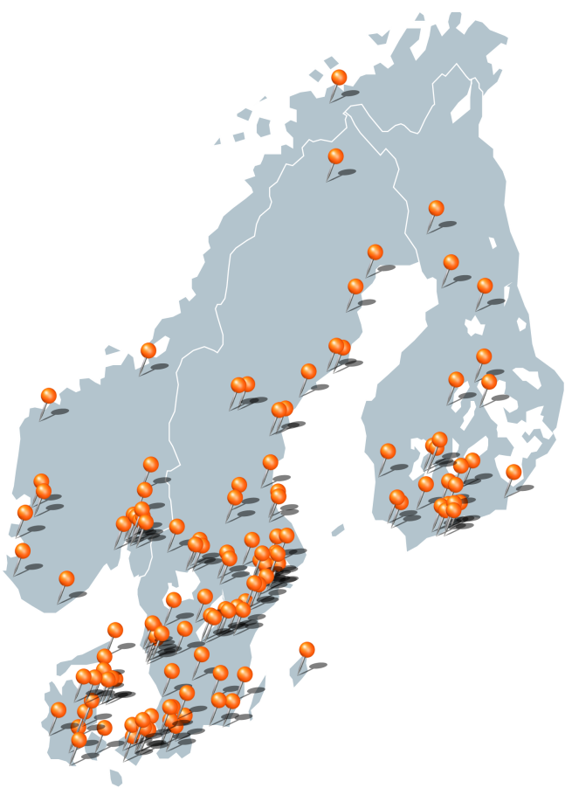
Scandic Facts
Opened in 1963 Esso Motor Hotel and is ten years later the leading hotel chain in Sweden
The first Scandic hotels in Norway and Denmark opened in 1972
The company and all of its hotels are renamed from Esso to Scandic Hotels in 1984
Was from the 1990’s the leading hotel chain when it came to corporate social responsibility, and was the first chain to only wash towels that guests left on the floor. This is today an industry standard. As early as in 1999 Scandic had its first Swan-labelled hotel
In 1998 Scandic acquires Arctia, Finland’s third largest hotel chain
Scandic received in 2011 the prestigious Nordic Council Environment Prize for its efforts to promote sustainable tourism in the Nordic region and the rest of the world
In 2013 Scandic entered into its 50th year with 150 hotels in eight countries and close to 30,000 hotel rooms
Scandic in numbers:
Coverage: 151 hotels in Norway, Sweden, Denmark, Finland, Germany, the Netherlands, Belgium and Poland
Number of employees: Approximately 10,000
Occupancy rate (2012): 60.9 %
EBIT in 2012: EUR 923 million
EBITDA in 2012: EUR 83.7 million
Number of hotels/rooms: 151/29.709
  Sweden: 75/14,914
  Norway: 19/3,887
  Denmark: 23/3,867
  Finland: 27/5,448
  Germany: 2/886
  The Netherlands: 1/96
  Belgium: 2/304
  Poland: 2/307
New hotels planned: 3
  Sweden: 1 (Scandic Continental)
  Norway: 2 (Scandic Stavanger City and Scandic Lerkendal)

Slide 3
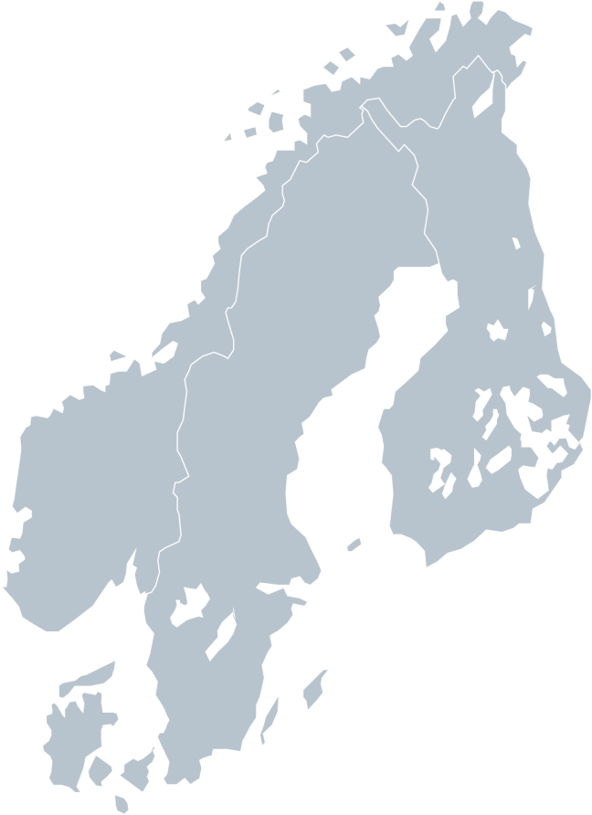
RICA HOTELS Facts
Rica Hotels was started by Jan E. Rivelsrud in 1975 and has since been controlled by the Rivelsrud family
Starting up initially as a small restaurant business situated in Bygdøy Allé in Oslo, the company soon expanded into the hotel industry by purchasing and entering into agreements with hotels across all of Norway
In the 1990s the company focused on expanding its hotel business
Rica’s first establishment abroad occurred in 1998 by acquiring six hotels from City Hotels Holding AB in Sweden
In 1994 Rica became the first Norwegian hotel chain listed on the Oslo Stock Exchange. The company was publicly traded for twelve years until the chairman and majority shareholder Jan E. Rivelsrud acquired the remaining shares in 2006. Rica was consequently delisted
Rica Hotels in Numbers:
Coverage: 72 hotels in 49 destinations in Norway and Sweden. Two new hotels will open in 2014. Rica Hotels also operates Nordkapphallen, Sápmi Park and cooperates with Oslo Congress Centre
Number of employees: Approximately 3,000
Occupancy rate (2012): 61%
Turn-over in 2012: NOK 2.5 bn
Profits before tax in 2012: NOK 109 million
Number of hotels/rooms: 72 /10,549
  Sweden: 7/1,204
  Norway: 65/9,345
Planned new hotels: Rica Hotels has several hotel projects planned in Norway and Sweden, hereunder expansion of existing hotels. Rica Ørnen Hotel in Bergen and Rica Havet Hotel in Bodø will open in 2014
Spitsbergen hotel, Svalbard

Slide 4
Facts of Scandic including Rica Hotels
Scandic becomes the largest hotel chain in the Nordic region with 223 hotels and more than 40,000 beds
Rica Hotels will be rebranded to Scandic, but the integration process and rebranding will not take place before the acquisition is approved by the competition authorities
Rica guests can look forward to an offer based on the same good qualities also after the integration, including the prize-winning breakfasts and the good hospitality. This will contribute to the continuous development of Scandic as the most sustainable hotel chain in the Nordic region
Scandic including Rica Hotels in number:
Coverage: 223 hotels in Norway, Sweden, Denmark, Finland, Germany, the Netherlands, Belgium and Poland
Number of employees: Approximately 13,000
Number of hotels/rooms: 223 /40,294
  Sweden: 82/16,118
  Norway: 84/13,528
  Denmark: 23/3,997
  Finland: 27/5,356
  Germany: 2/888
  The Netherlands: 1/96
  Belgium: 2/304
  Poland: 2/307
Spitsbergen hotel, Svalbard

